Slide 1
Deep Learning Training
Lecture 8: Miscellaneous Deep Learning Topics

Slide 2
Content
Object Detection
Object Segmentation
Generative Adversarial Network
Neural Style Transfer
Deep Reinforcement Learning
Multi-task Learning

Slide 3
Object Detection
Goal: Localize object in image, output coordinate for object bounding box and class probability
Some Notable object detection/segmentation architecture
Faster R-CNN
SSD
YOLO
RetinaNet
Earlier models had separate components for region proposal, feature extraction and classification
Now trained using unified model

Slide 4
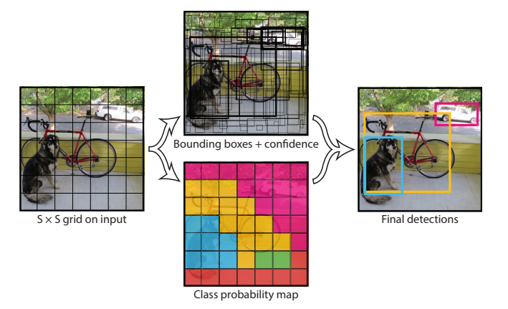
Object Detection: YOLO Network
Single convolutional neural network
Treats detection as regression problem
Outputs bounding box and probabilities for each class using single fully connected layer
Figure: YOLO model for detection

Slide 5
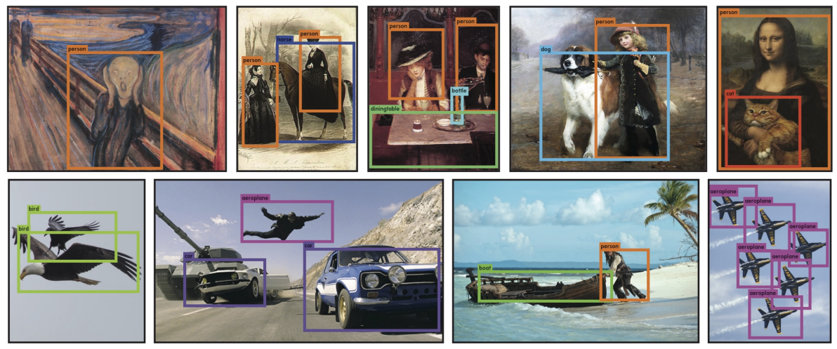
Object Detection: YOLO Network
Figure: Detection result using YOLO

Slide 6
Object segmentation
Goal: Pixelwise segmentation of object in image
Can be done using end-to-end convolutional neural net
Some are implemented in encoder-decoder architecture
Convolution and pooling to encode
Deconvolution and up-sampling for decoding
Notable architecture:
Fully Convolutional Network
U-Net
Mask R-CNN
DeepLab

Slide 7
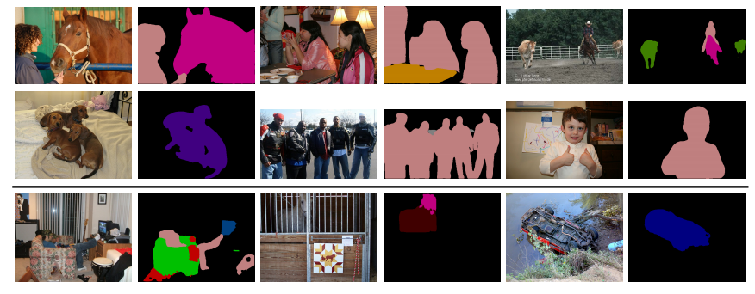
Object segmentation
Figure: Segmentation result obtained by DeepLabv3+

Slide 8
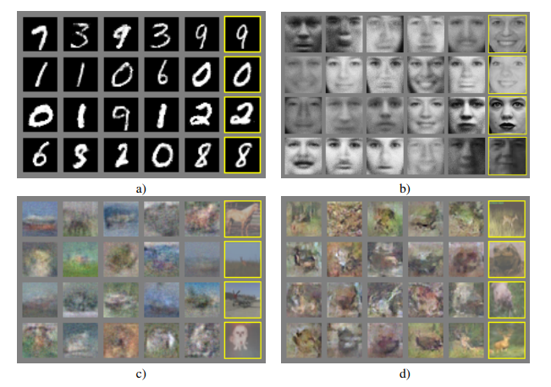
Generative Adversarial Network
Two neural networks compete with each other
Generative network: Generates candidates, goal is to fool the discriminative network
Discriminative Network: Discriminates between real and generated(fake) candidates
Figure: Samples generated by GAN. Rightmost column shows nearest training example

Slide 9
Generative Adversarial Network
2 player minmax game
Value function
Lots of variants
Conditional GAN
DCGAN
Cycle GAN
Style GAN
Wasserstein GAN
And more… Check it out!

Slide 10
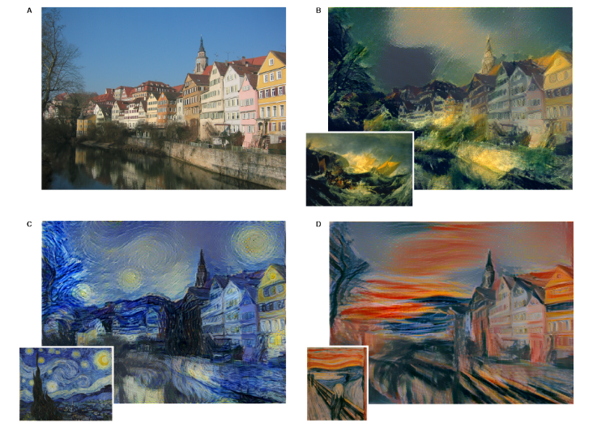
Neural Style Transfer
Change the appearance of an image or video in accordance with another image
CNN used for feature extraction
Try it!
Figure: top-left => Original artwork, Others=> image generated after applying style image (in inset) source

Slide 11
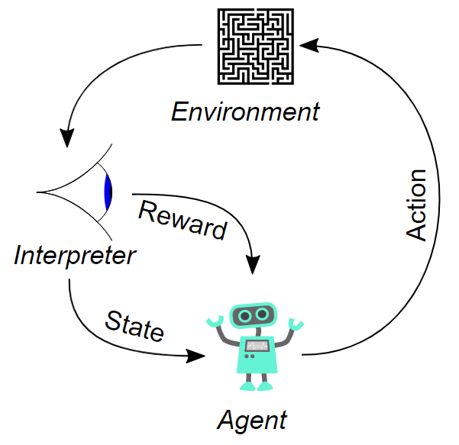
Reinforcement Learning
Concerned with how agents ought to take actions in an environment so as to maximize some notion of cumulative reward
Long term returns are considered instead of short term rewards
Different from supervised or unsupervised learning
Figure: Typical framing of a reinforcement learning scenario source

Slide 12
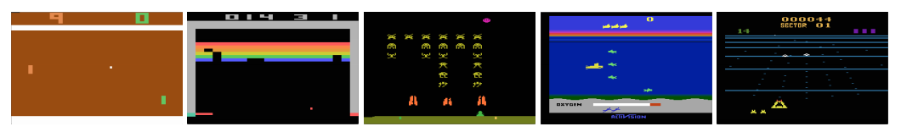
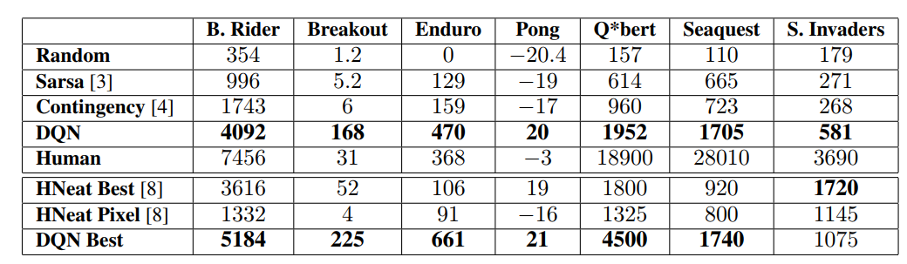
Deep Reinforcement Learning: Playing Atari
Playing Atari with Deep Reinforcement Learning
Figure: Screen shots from five Atari 2600 Games: (Left-to-right) Pong, Breakout, Space Invaders, Seaquest, Beam Rider
Table: Performance of different deep reinforcement learning models (compared with human player as well)

Slide 13
Deep Reinforcement Learning: Playing Go
Learn to play Go without human knowledge
Comprehensive performance even against world champions
Versions | Hardware | Elo rating | Matches
AlphaGo Fan | 176 GPUs, distributed | 3,144 | 5:0 against Fan Hui
AlphaGo Lee | 48 TPUs, distributed | 3,739 | 4:1 against Lee Sedol
AlphaGo Master | 4 TPUs, single machine | 4,858 | 60:0 against professional players; Future of Go Summit
AlphaGo Zero | 4 TPUs, single machine | 5,185 | 100:0 against AlphaGo Lee89:11 against AlphaGo Master
AlphaZero | 4 TPUs, single machine | N/A | 60:40 against AlphaGo Zero

Slide 14
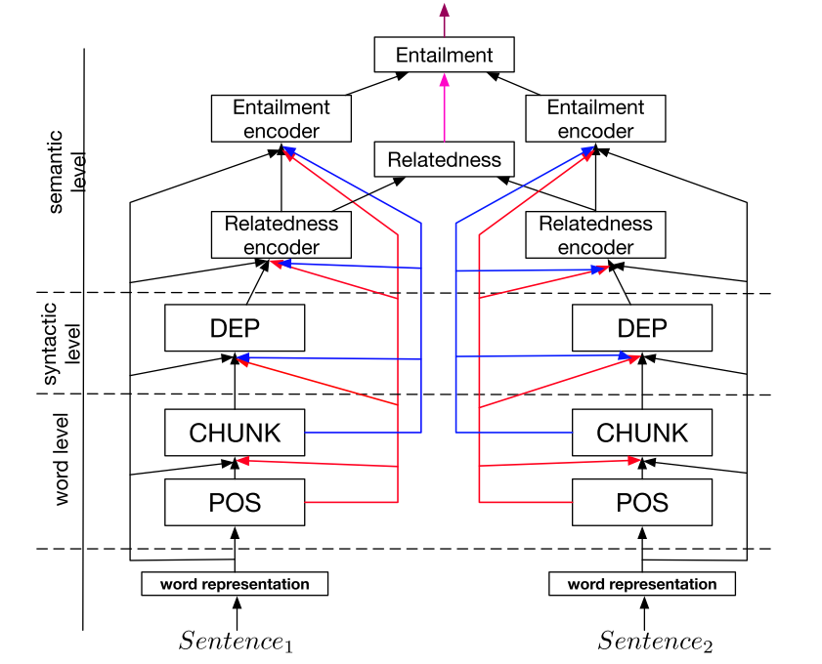
Multitask Learning
Attempt to solve multiple different tasks with single neural net
Can learn richer representation
Works as regularizer to prevent overfitting
Shared parameters
Hard parameter sharing
Soft parameter sharing
Figure: A joint many task model for NLP source

Slide 15
Thank You

Slide 16
Reference
You Only Look Once
Faster R-CNN
SSD: Single Shot MultiBox Detector
U-Net
Mask R-CNN
DeepLab
DeepLabv3+
Generative Adversarial Nets
A Neural Algorithm of Artistic Style
Playing Atari with Deep Reinforcement Learning
https://en.wikipedia.org/wiki/AlphaGo
https://arxiv.org/pdf/1706.05098.pdf

